Slide 1
Creating accessible HTML tables
The Accessibility Conference 2015
University of Guelph
By
@TouficSbeiti
@Duboi5p

Slide 2

Introduction
Name
Work / Study
Level of knowledge on web accessibility
Expectations

Slide 3

Learning outcomes
Learn how to code various type of accessible tables in HTML
Learn to use free tools to test and validate HTML tables
Add various functionalities to HTML table such as search, filter and pagination
Code tables that are mobile friendly

Slide 4

Table of content
Types of tables
How to code accessible tables
Testing tables for accessibility
Simplifying tables
Advanced table features
Responsive tables

Slide 5




TYPES

Slide 6
Type of tables
Data Tables are used to organize data with a logical relationship. Accessible tables need HTML markup that indicates header cells and data cells, and defines their relationship.
Layout Tables do not have logical headers that can be mapped to information within the table cells. Layout table are used to control the display of elements in a page.

Slide 7
Type of data tables
Tables with one header
Tables with two headers
Tables with irregular headers
Tables with multi level headers

Slide 8

Types of data tables

Slide 9

CODE

Slide 10
HTML elements
<table>
Caption
<caption>
<tr>
header
header
<th>
<th>
<tr>
data
data
<td>
<td>
<tr>
data
data
<td>
<td>
<table>

Slide 11
HTML table elements

Slide 12
Cell functions (th,td)
Layout: Use for presentation (Empty cell, layout table)
Header: Define a series of cells (th)
Data: Pieces of information
Description: Provide additional information to support a header
Offset: Data cell that is located prior the header
Summary: Data cells that summaries other data cells

Slide 13
HTML table attributes
Attribute | Used with | Purpose | Syntax
colspan | <th> , <td> | Number of columns that the cell is to span | <th colspan="4”>
rowspan | <th> , <td> | Number of rows that the cell is to span | <th rowspan="3">
scope | <th> | Specifies which cells the header applies to | <th scope=“col”>
id | <th> | Cell unique identifier | <th id="h2">
headers | <th> , <td> | List of cell ids used are headers for a cell | <td headers="h1 h2">
abbr | <th> | Alternative label can be used by user agents when listing the headers cells (th) | <th abbr="Make">Toy manufacturer<th>
border | <table> | Draw a line around cell | <table border="1">
Additional attribute: sortable on <table> elements means to enables a sorting interface for the table. And sorted on <th> elements means column sort direction and ordinality.

Slide 14
Coding

Slide 15

Testing

Slide 16

Success Criterion
1.3.1 - Info and Relationships
Information, structure, and relationships conveyed through presentation can be programmatically determined or are available in text. (Level A)
1.3.2 - Meaningful Sequence
When the sequence in which content is presented affects its meaning, a correct reading sequence can be programmatically determined. (Level A)

Slide 17
HTML techniques
G57: Ordering the content in a meaningful sequence
H39: Using caption elements to associate data table captions with data tables
H43: Using id and headers attributes to associate data cells with header cells in data tables
H51: Using table markup to present tabular information
H63: Using the scope attribute to associate header cells and data cells in data tables
H73: Using the summary attribute of the table element to give an overview of data tables
H79: Identifying the purpose of a link using link text combined with its enclosing table cell and associated table headings

Slide 18
WCAG failures
F34: Failure of Success Criterion 1.3.1 and 1.3.2 due to using white space characters to format tables in plain text content
F46: Failure of Success Criterion 1.3.1 due to using th elements, caption elements, or non-empty summary attributes in layout tables
F49: Failure of Success Criterion 1.3.2 due to using an HTML layout table that does not make sense when linearized
F90: Failure of Success Criterion 1.3.1 for incorrectly associating table headers and content via the headers and id attributes
F91: Failure of Success Criterion 1.3.1 for not correctly marking up table headers

Slide 19

Tools

Slide 20
FireFox Add-ons
Web Developer Toolbar
Jim Thatcher Favelets
Juicy Studio Accessibility Toolbar

Slide 21
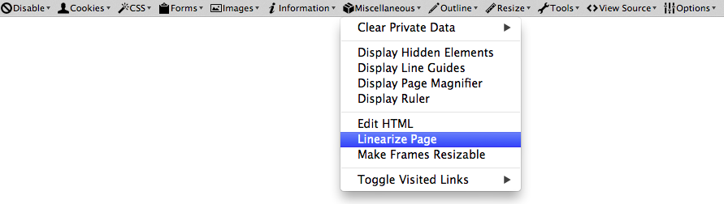
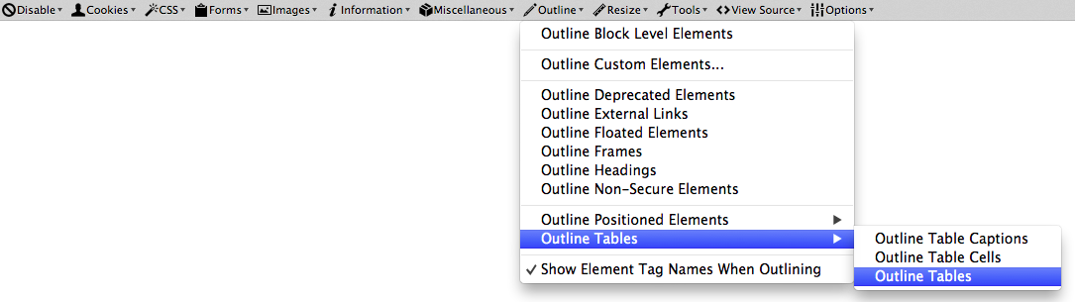
Web Developer Toolbar

Slide 22
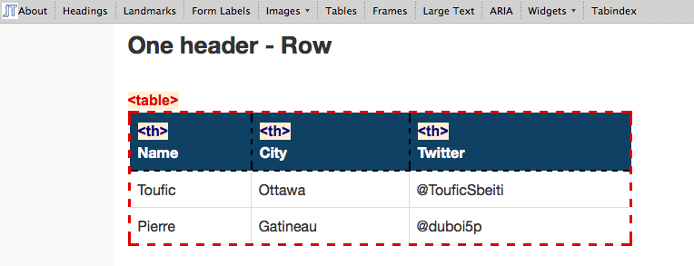
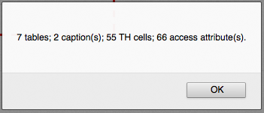
Jim Thatcher Favelets

Slide 23
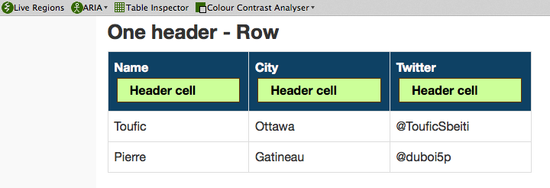
Juicy Studio Accessibility Toolbar

Slide 24
Testing FireFox Add-ons

Slide 25

Screen reader testing

Slide 26
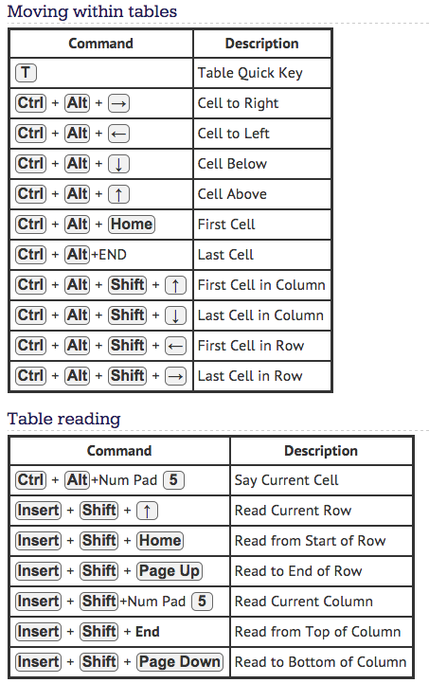
JAWS

Slide 27
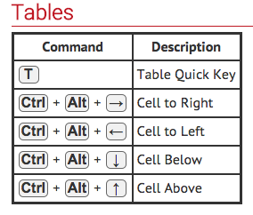
NVDA

Slide 28
Testing with screen readers

Slide 29

Simplifying table

Slide 30

Why simplified ?
Split up a multi-level tables
Too complex to code
Cells are not presented in a logical way
Relationship between headers and data is ambiguous
Table is not designed correctly

Slide 31
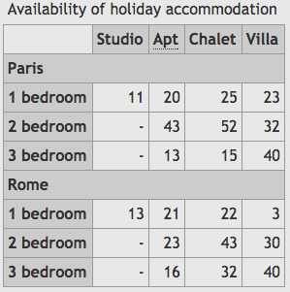
Split up a multi-level tables

Slide 32
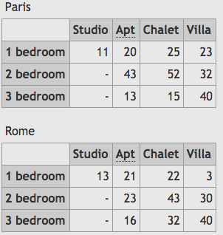
Split up a multi-level tables

Slide 33
Proposed approach
Understand the relationship between the cells
Clean the table
  Remove visual styles
  Keep only basic elements
  Ensure to identify cells correctly (th and td)
Prepare and change table structure
  Add/move/regroup headers as necessary
  Split-up multi level if necessary
  Refactoring the cells
Re-validate the relationship between the cells
Try to improve the structure further (step 3)

Slide 34
Simplifying table

Slide 35
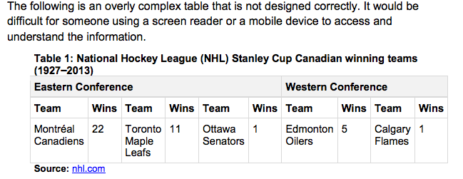
Example

Slide 36
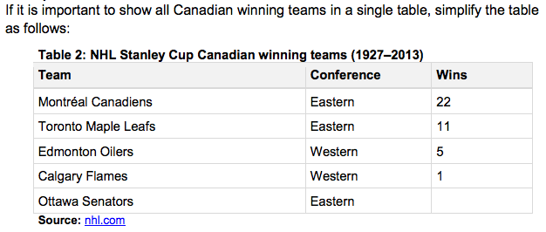
Answer 1

Slide 37
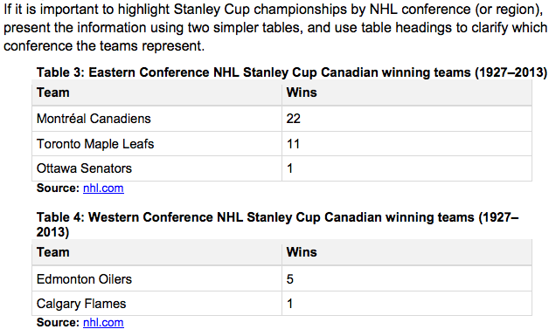
Answer 2

Slide 38

Advanced features

Slide 39
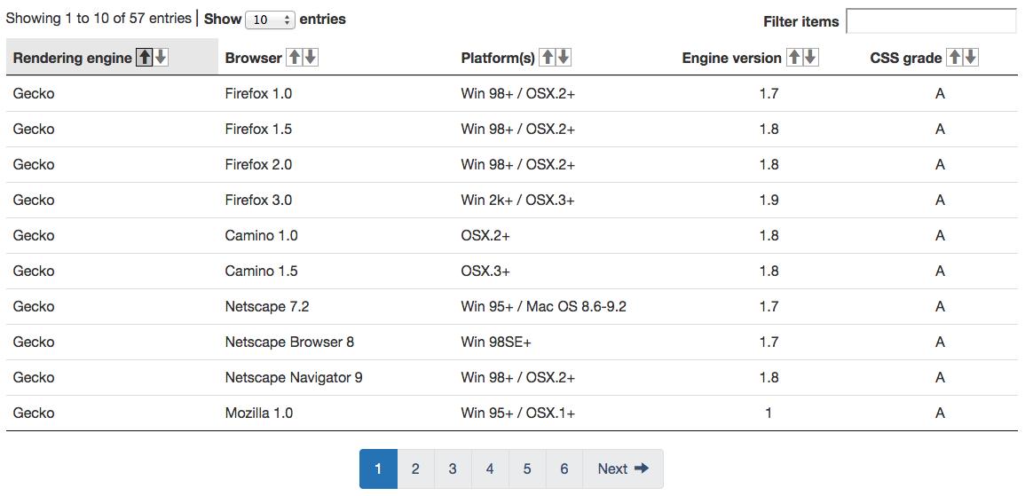
Datatable plugin
View enhancement
Search
Sortable
Pagination

Slide 40
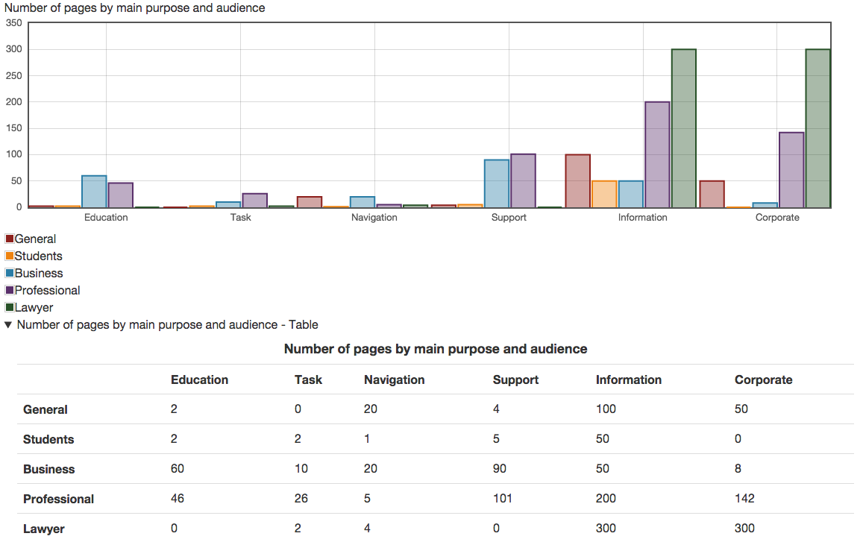
Charts

Slide 41
Tables validator
The table validator is a web editor tool that helps to produce tables that conform to WCAG 2.0. This tools helps to identify relationship errors within a complex table.

Slide 42
Advanced features

Slide 43

Responsive tables

Slide 44
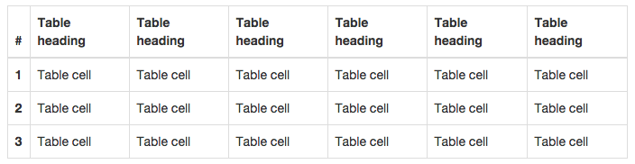
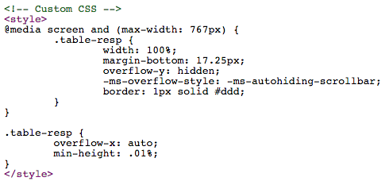

Bootstrap

Slide 45
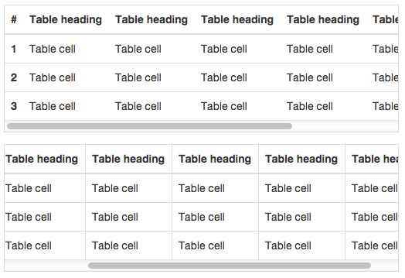
Bootstrap

Slide 46
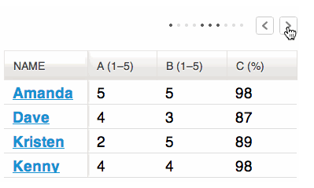
Tablesaw
Swipe Allows the user to use the swipe gesture (or use the left and right buttons) to navigate the columns.

Slide 47
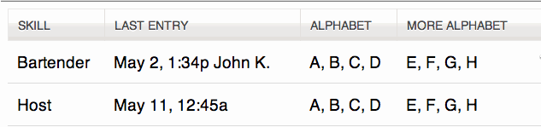
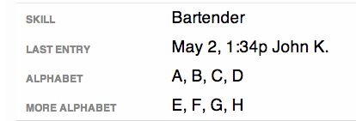
Tablesaw
Stack stacks the table headers to a two column layout with headers on the left when the viewport width is less than 40em (640px).

Slide 48
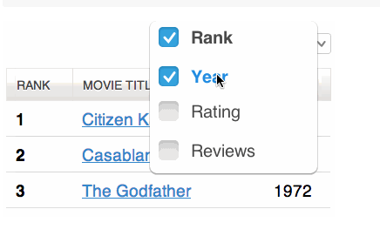
Tablesaw
Toggle allows the user to select which columns they want to be visible.

Slide 49
Responsive tables

Slide 50

@TouficSbeiti
@Duboi5p

Slide 51
References
Web Accessibility Tutorials
http://www.w3.org/WAI/tutorials/tables/one-header/
Web Experience Toolkit (WET)
http://wet-boew.github.io/wet-boew/index-en.html
Bootstrap responsive tables
http://getbootstrap.com/css/#tables
WCAG techniques
http://www.w3.org/WAI/GL/WCAG20-TECHS/
Data table plugin
https://www.datatables.net/
Keyboard shortcuts for NVDA
http://webaim.org/resources/shortcuts/nvda
Web Accessibility Content Guidelines
http://www.w3.org/TR/WCAG20/
Tablesaw
https://github.com/filamentgroup/tablesaw

Slide 52
Tools
Web Developer Toolbar https://addons.mozilla.org/en-US/firefox/addon/web-developer/
Jim Thatcher Favelets
http://jimthatcher.com/favelets/
Juicy Studio Accessibility Toolbar https://addons.mozilla.org/en-US/firefox/addon/juicy-studio-accessibility-too/
Job Access With Speech - JAWShttp://www.freedomscientific.com/Products/Blindness/JAWS
NonVisual Desktop Access- NVDA
http://www.nvaccess.org/download/

